Slide 1
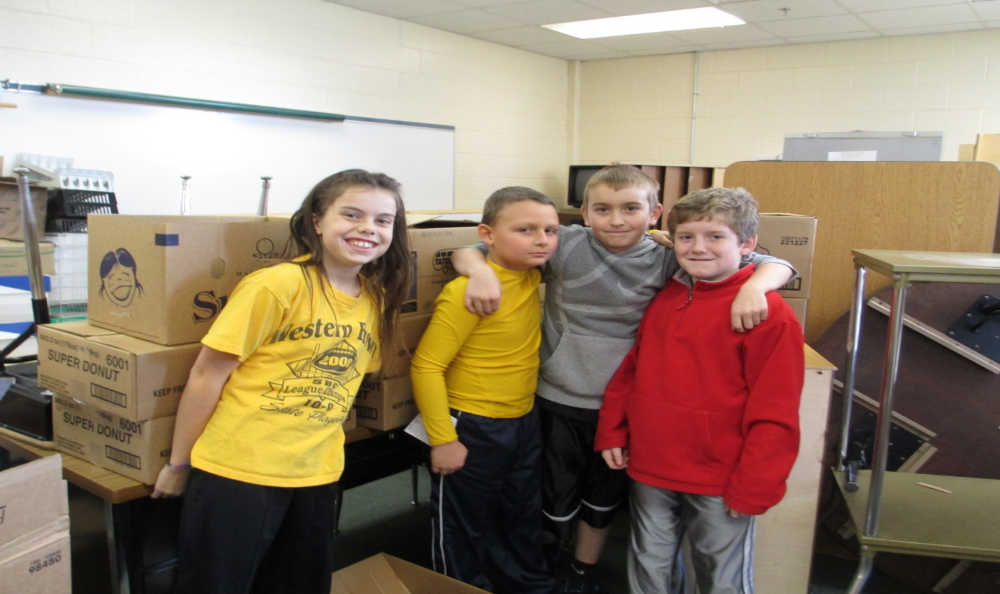
Mt. Orab Elementary Student Council Recycling Team

Slide 2
Student Council Each 4th grade classroom elects two representatives. Student Council members act as school leaders on a number of activities each school year.

Slide 3
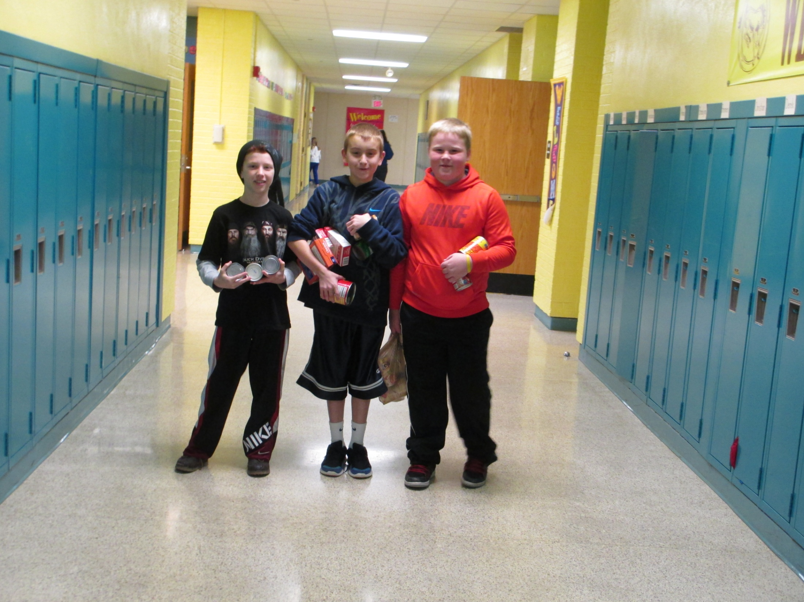

Slide 4
October is Anti-Bully Month This October Student Council presented a play called The Amazing Bully Machine. We sponsored a Door Decorating contest. We had a winner in each grade level.

Slide 5
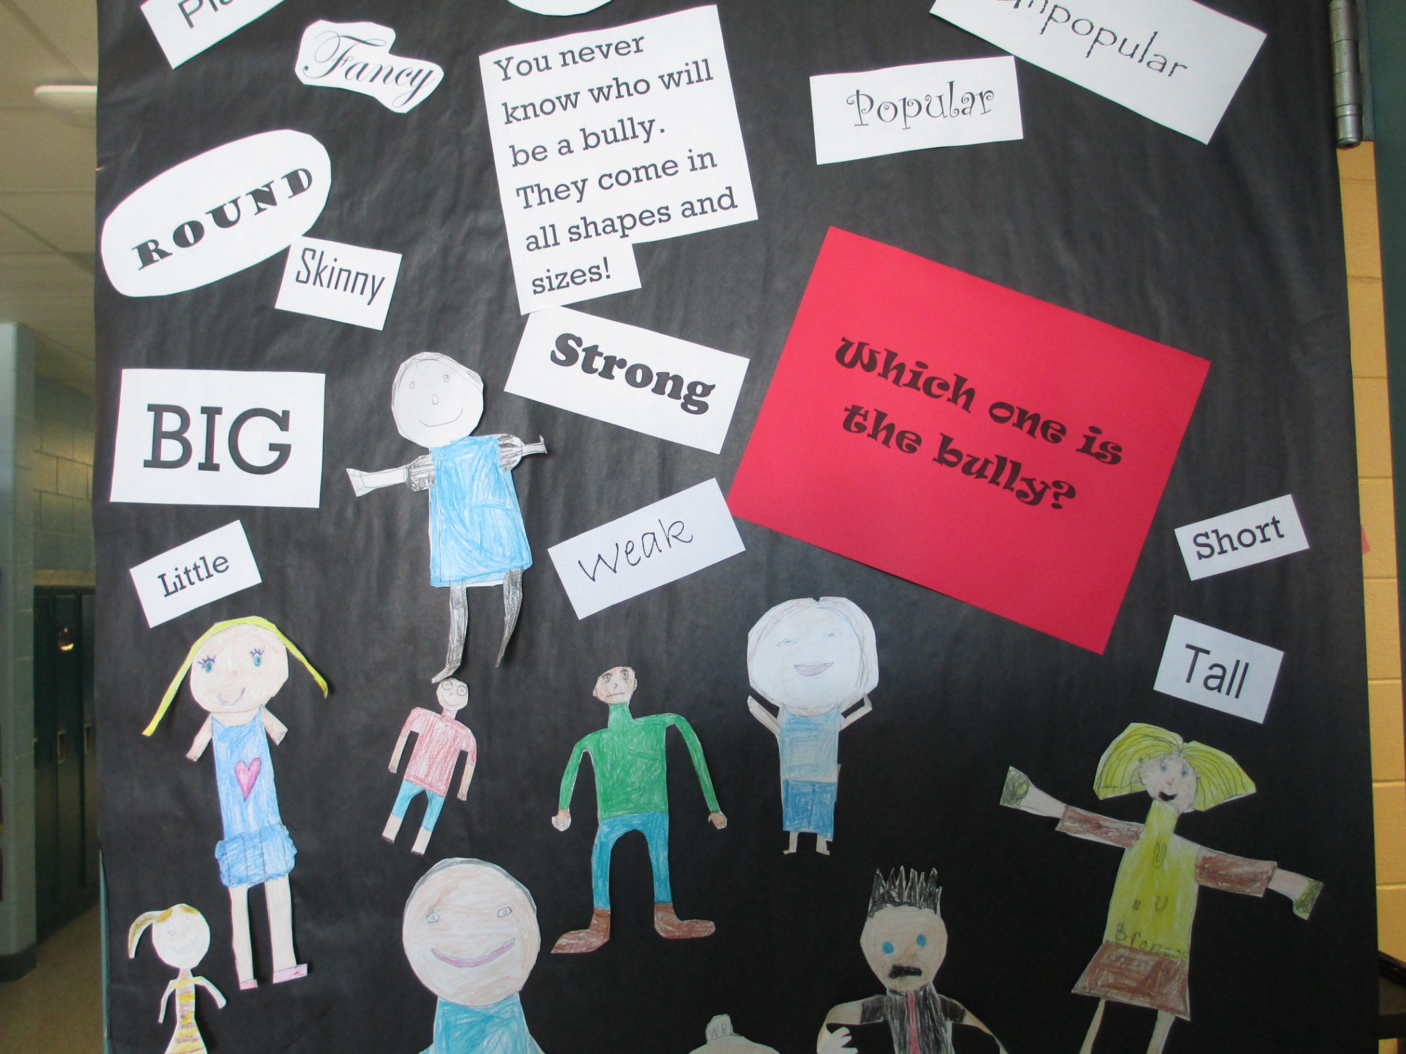

Slide 6
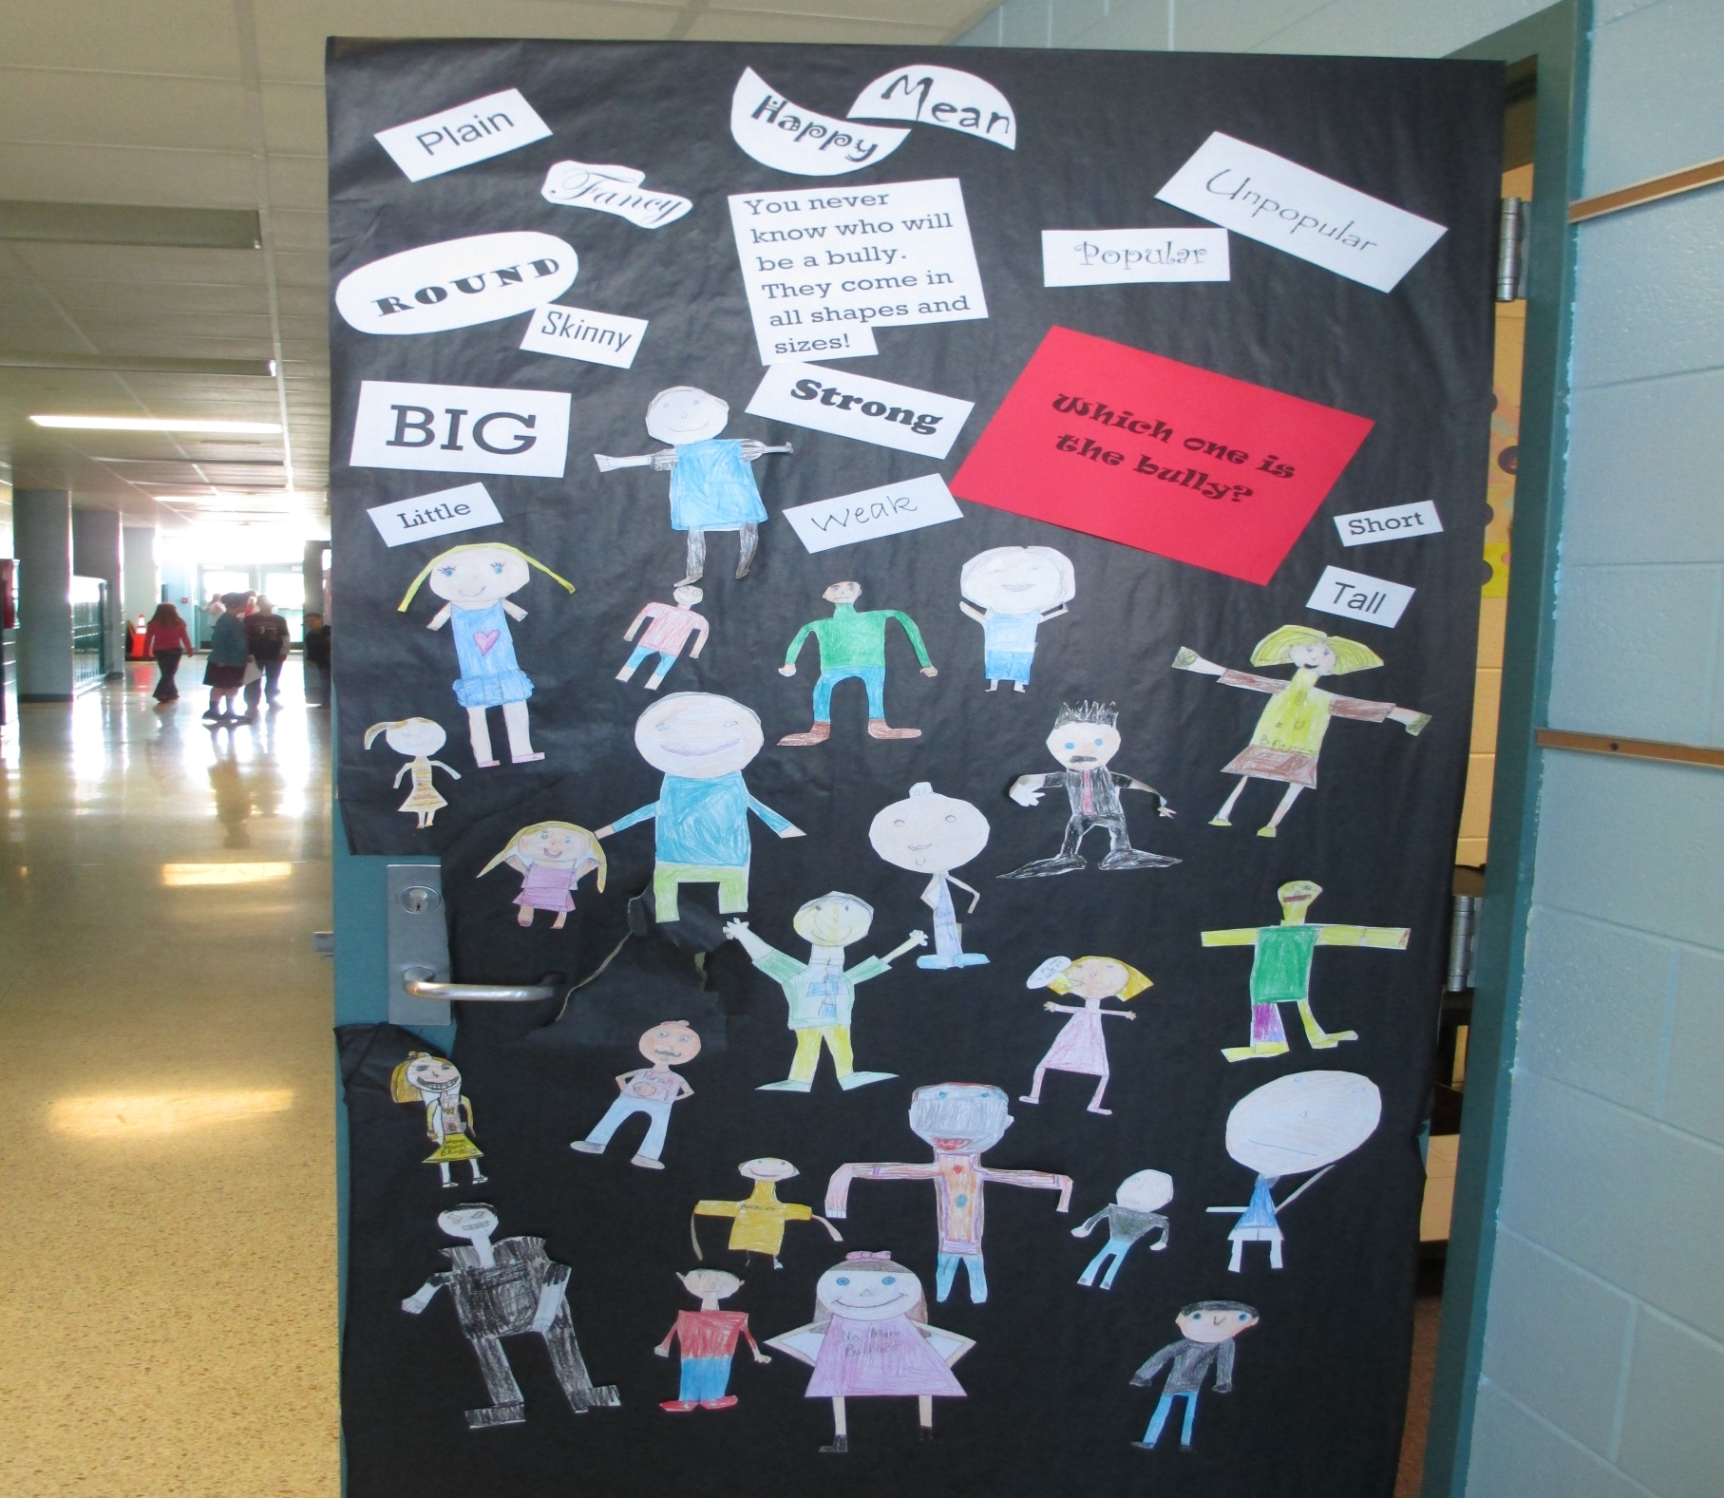

Slide 7
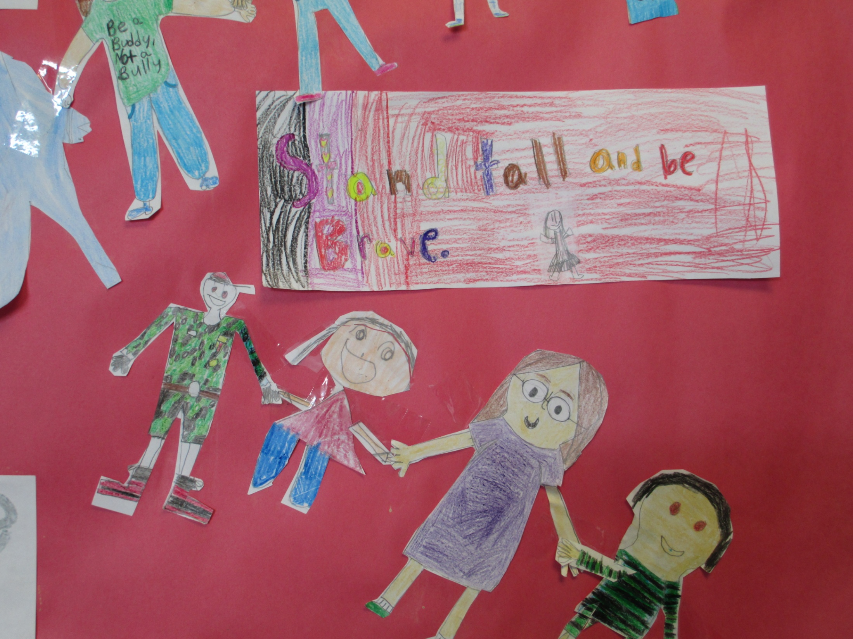

Slide 8
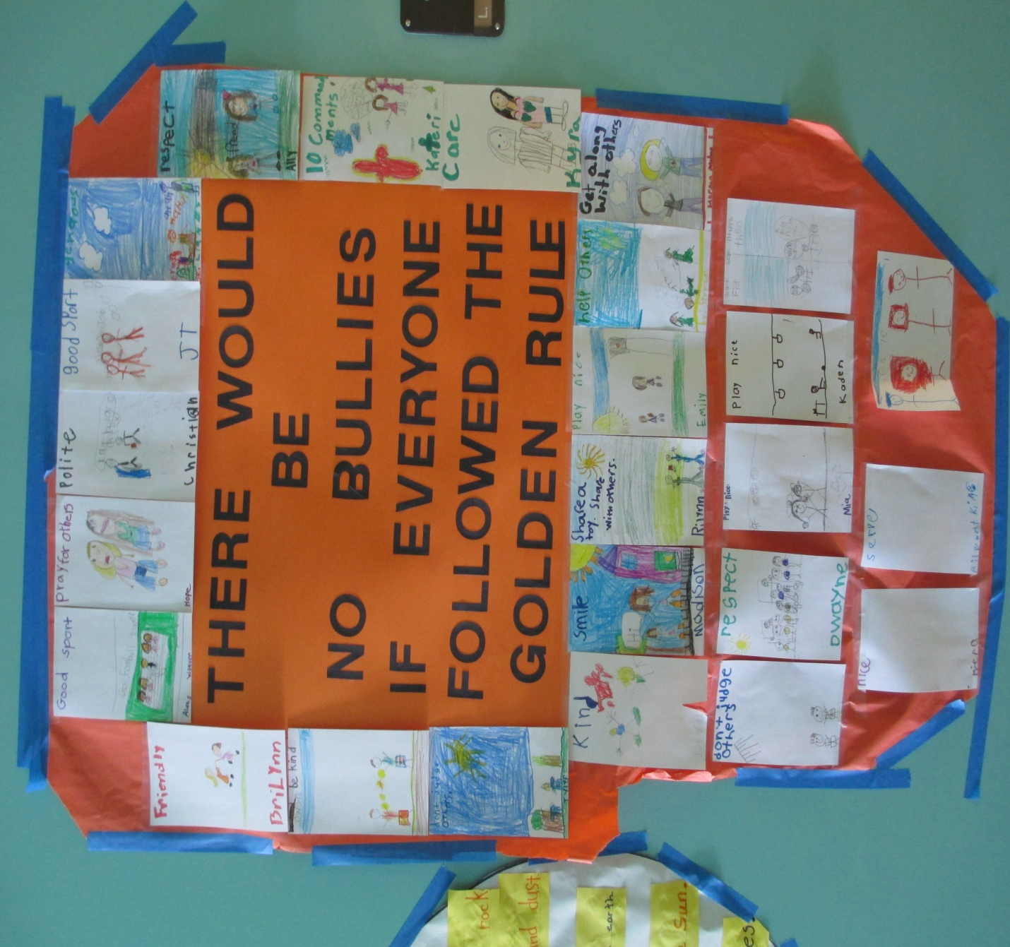

Slide 9
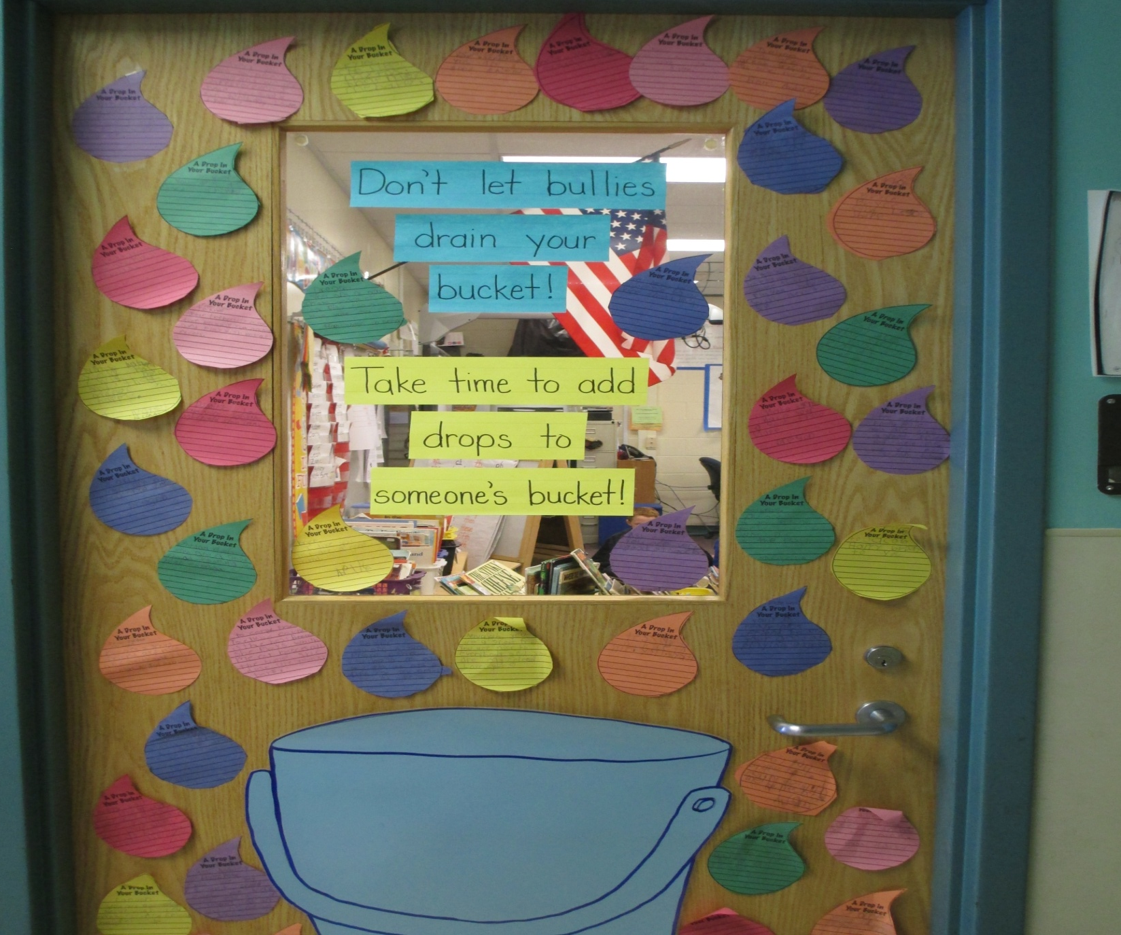

Slide 10
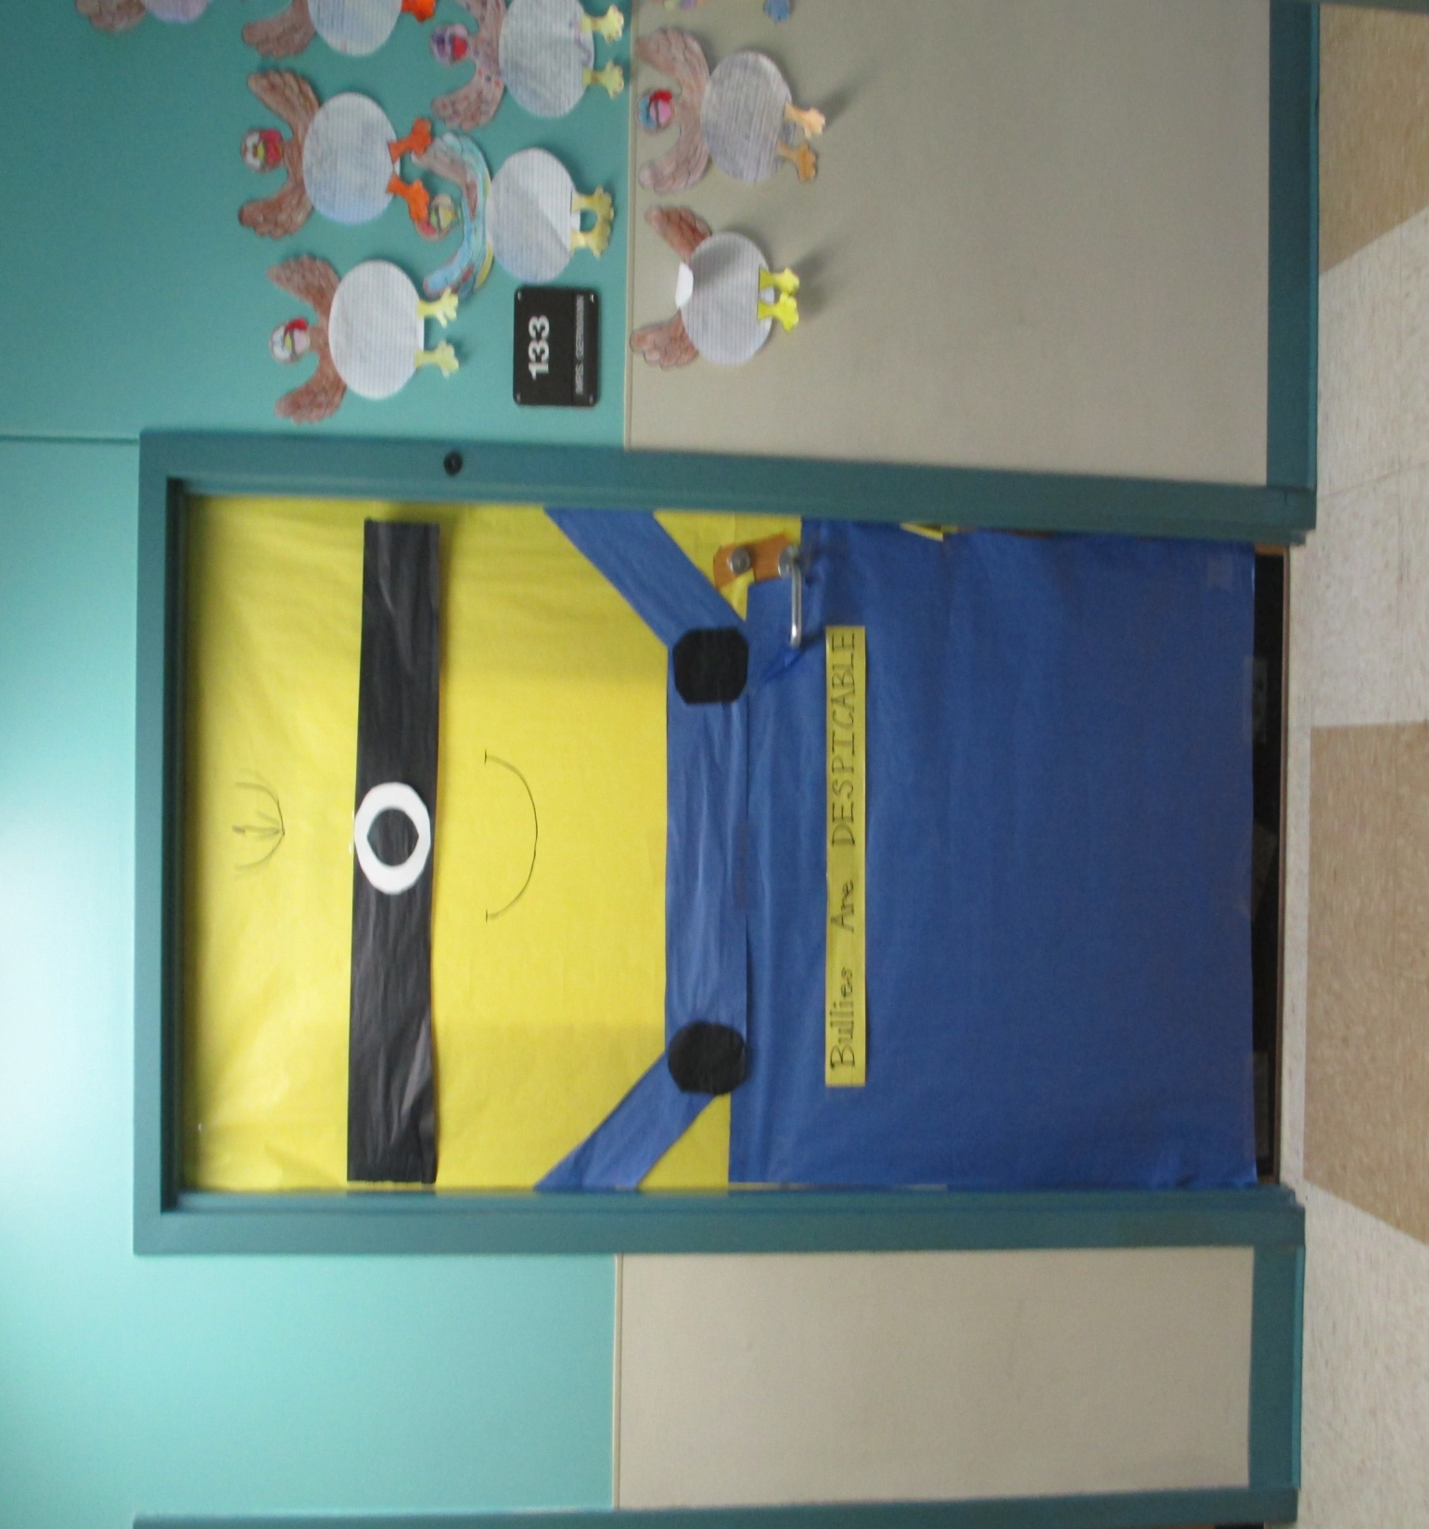

Slide 11
We presented The Amazing Bully Machine for all students at Mt. Orab Elementary. Our play taught about three kinds of bullying: Physical aggression, name calling and teasing, and social bullying.

Slide 12
In each scene we acted out how students can step in when they see bullying and become an important part of The Amazing Bully Machine.

Slide 13
“What’s The Amazing Bully Machine?” A bully machine fights bullies! It’s not a robot, it’s not even a machine. The Amazing Bully Machine is powered by boys and girls. When you see a bully, you can put the Amazing Bully Machine to work. We learned several ways to deal with bullies:

Slide 14
1. Politely, but firmly challenge the bully. 2.Refuse to go along with bullying behavior. 3. Rescue! Kids can quickly get a bullied kid out of a bad situation. 4. Report bullying to an adult.

Slide 15
Meet our social bully Lori. She tries to destroy friendships and threatens social standing. Watch how her group stands up to her.

Slide 16
Since November, Student Council and some 4th grade volunteers have been working on our canned food drive. We have collected more than 2000 items for the Church of Christ Food Pantry right here in town.

Slide 17
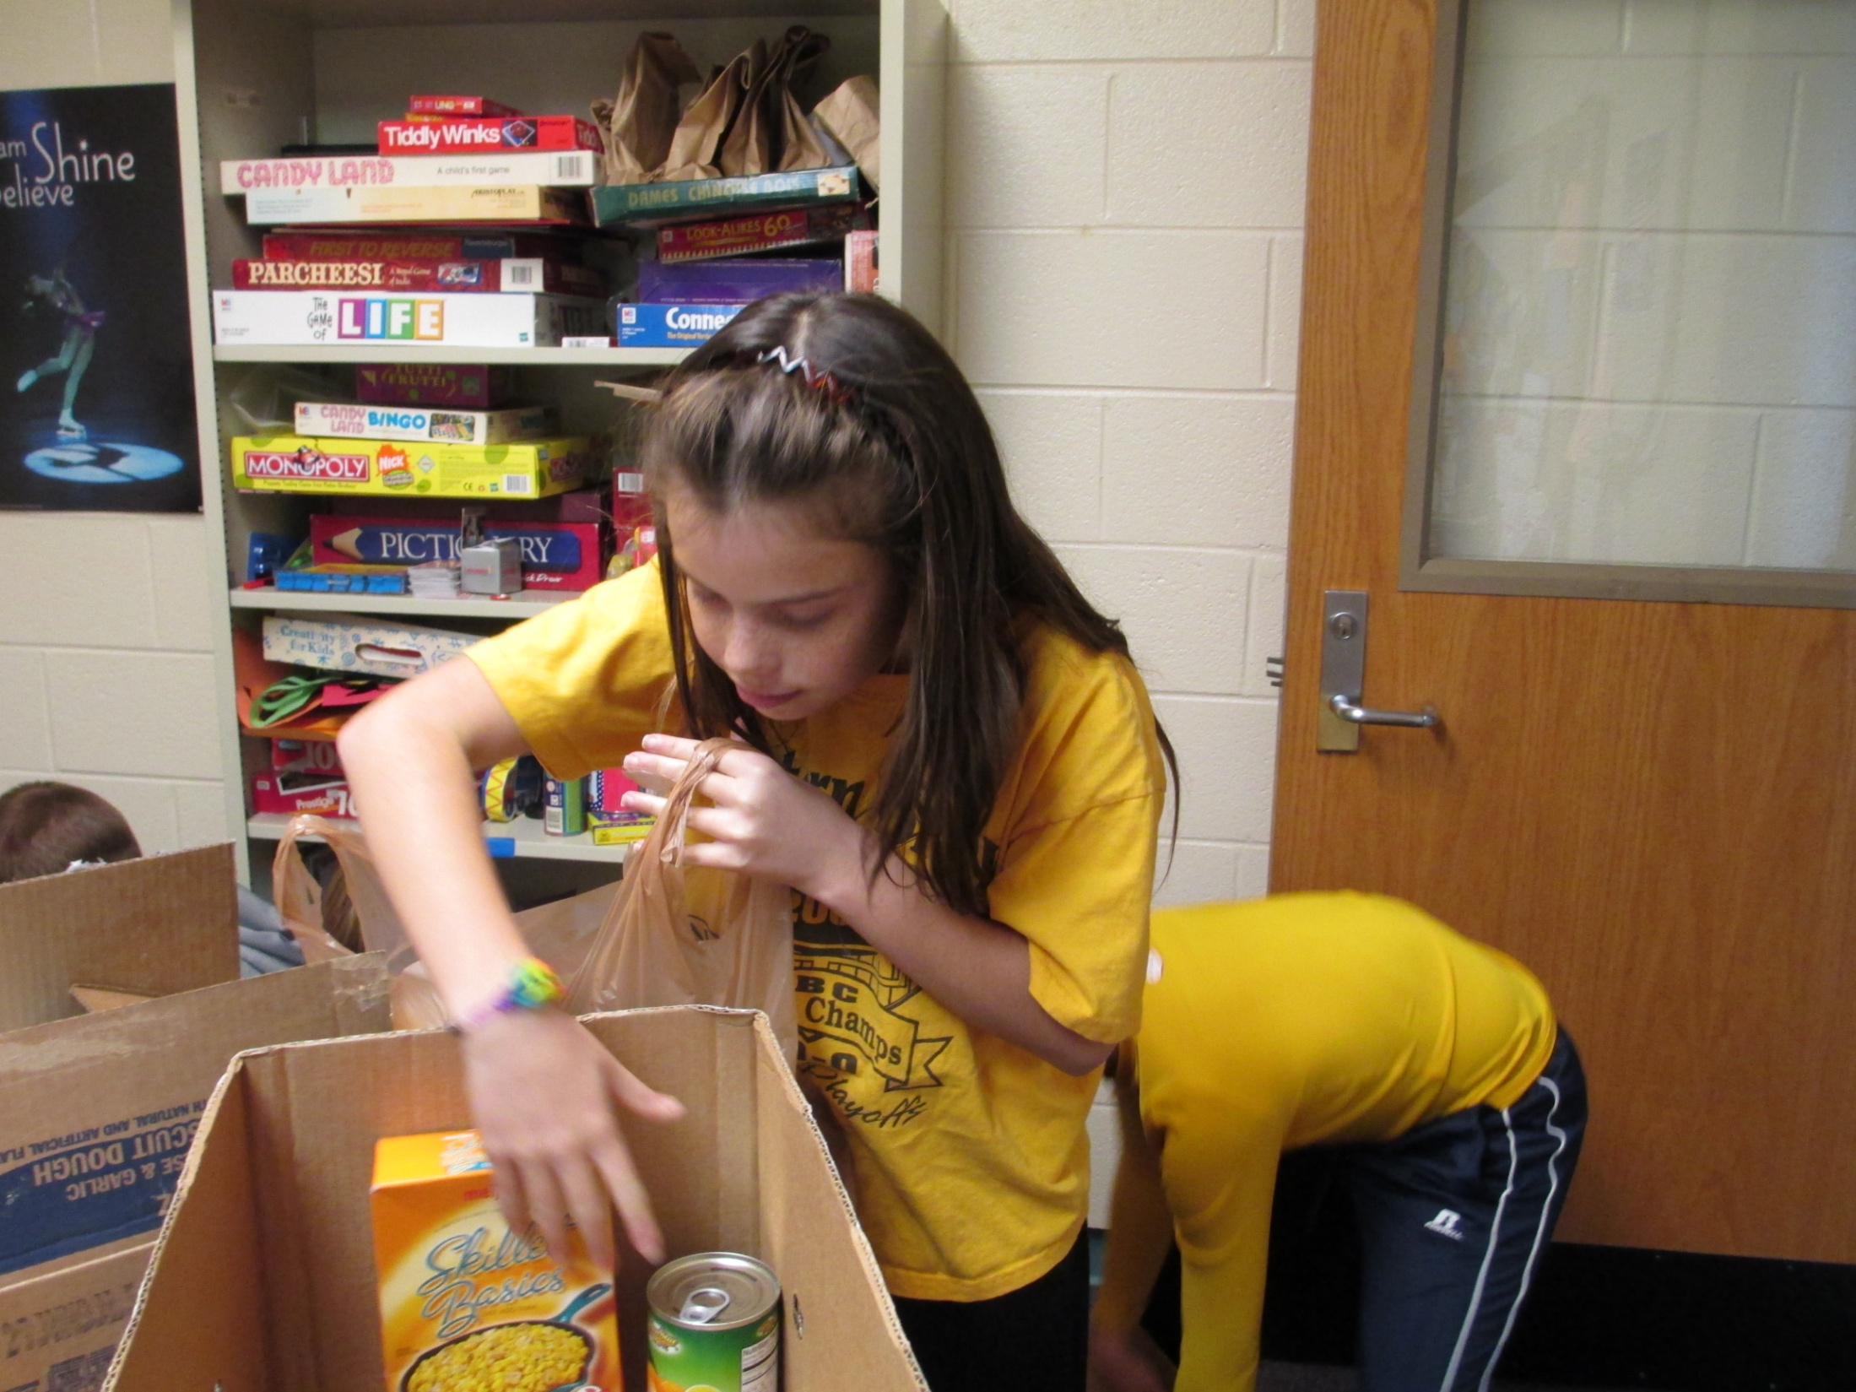

Slide 18
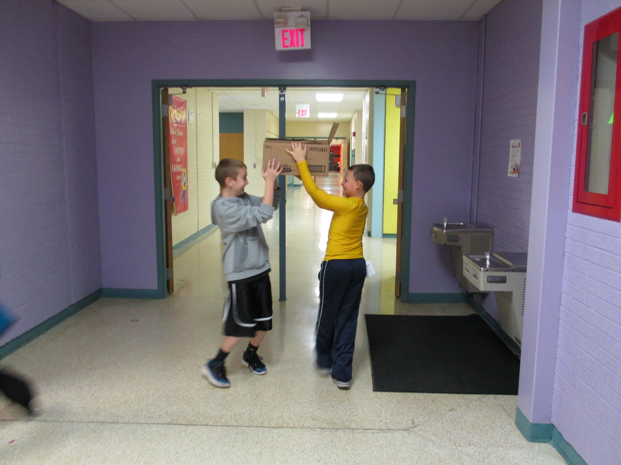

Slide 19
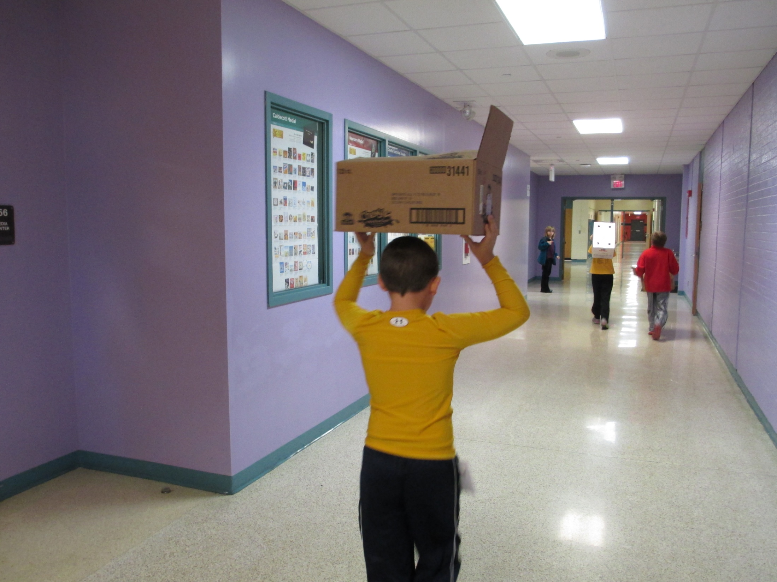

Slide 20
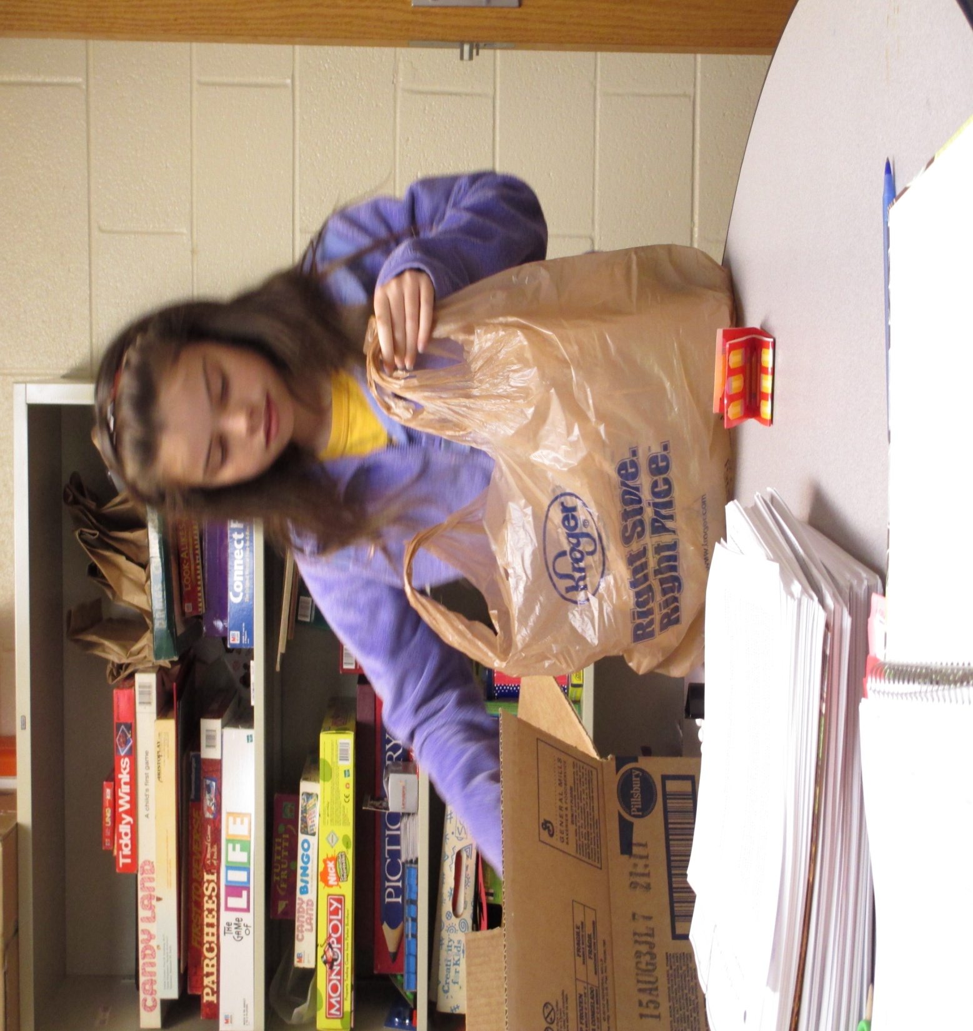

Slide 21
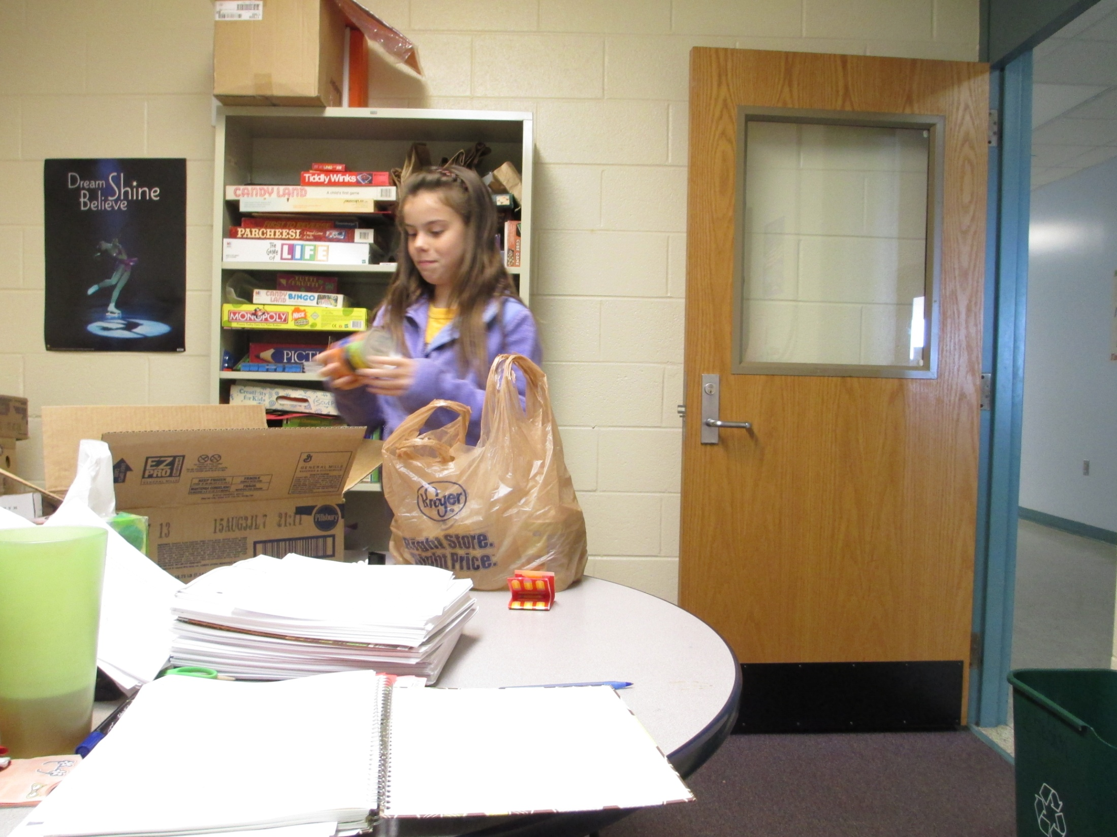

Slide 22
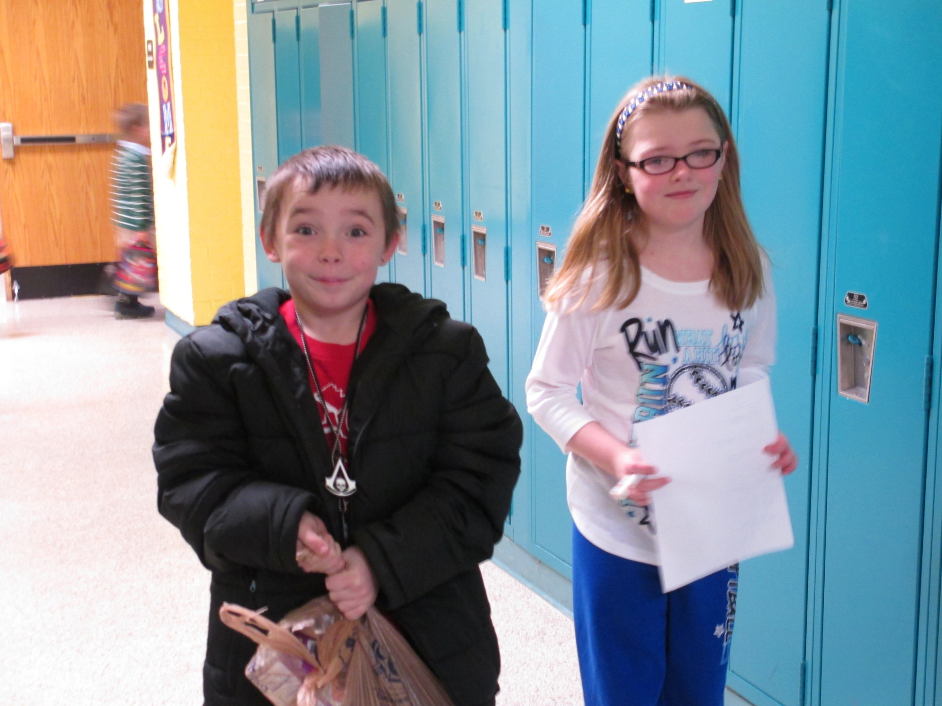

Slide 23
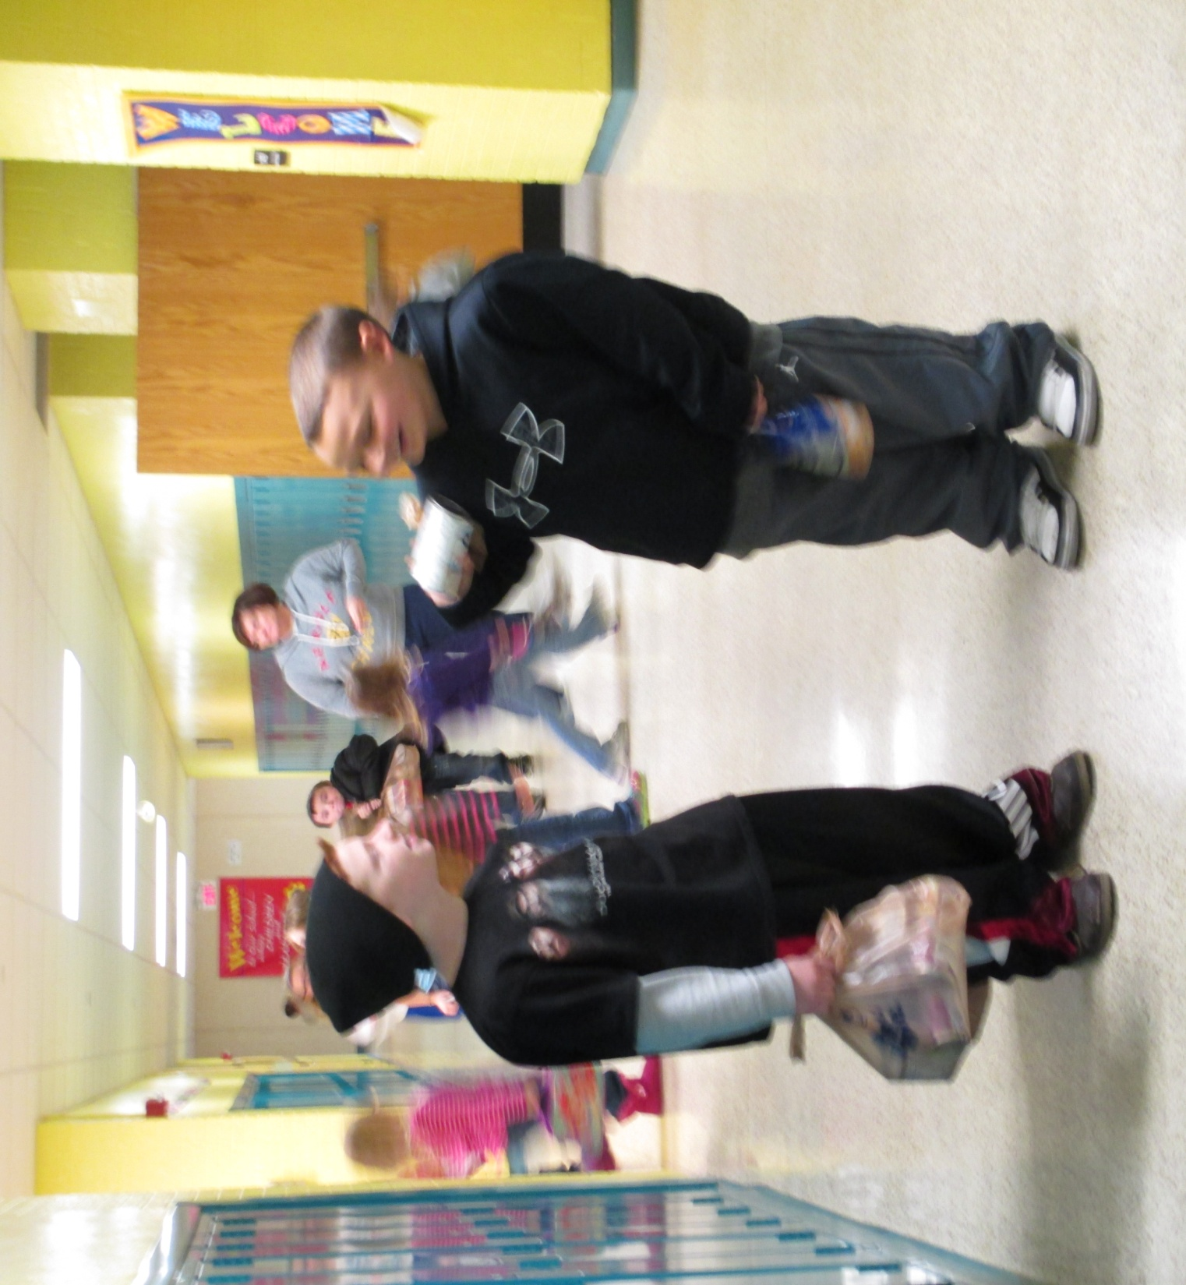

Slide 24
Our Recycling Team is busy every Tuesday. We collect the recycling bins from the classrooms and offices and deposit them in the massive bin behind our school.

Slide 25
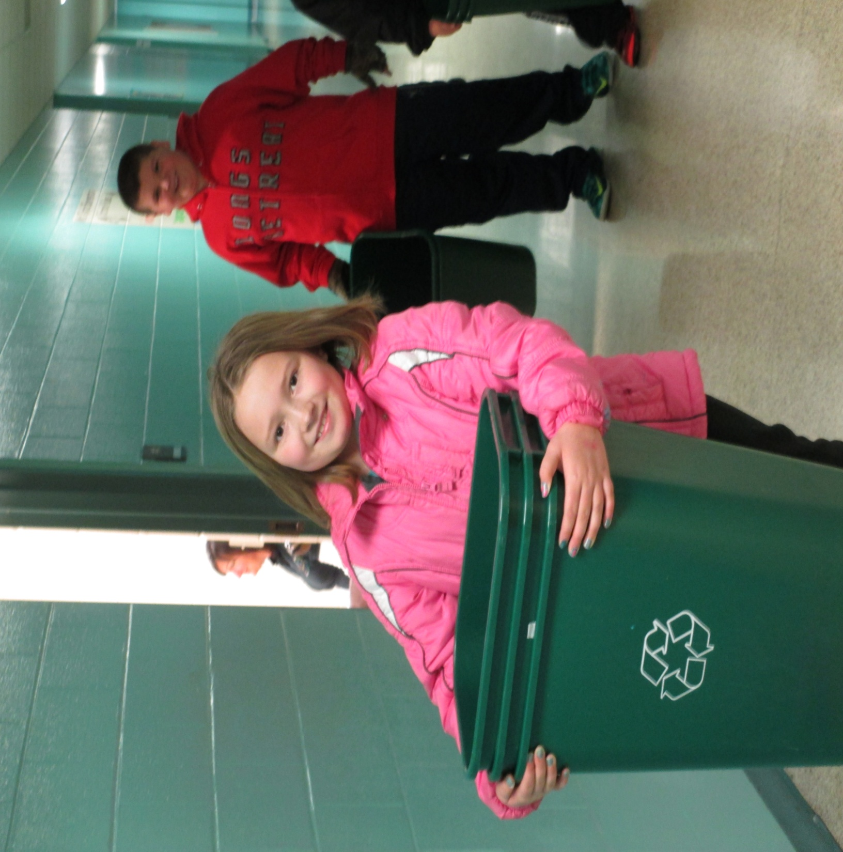

Slide 26
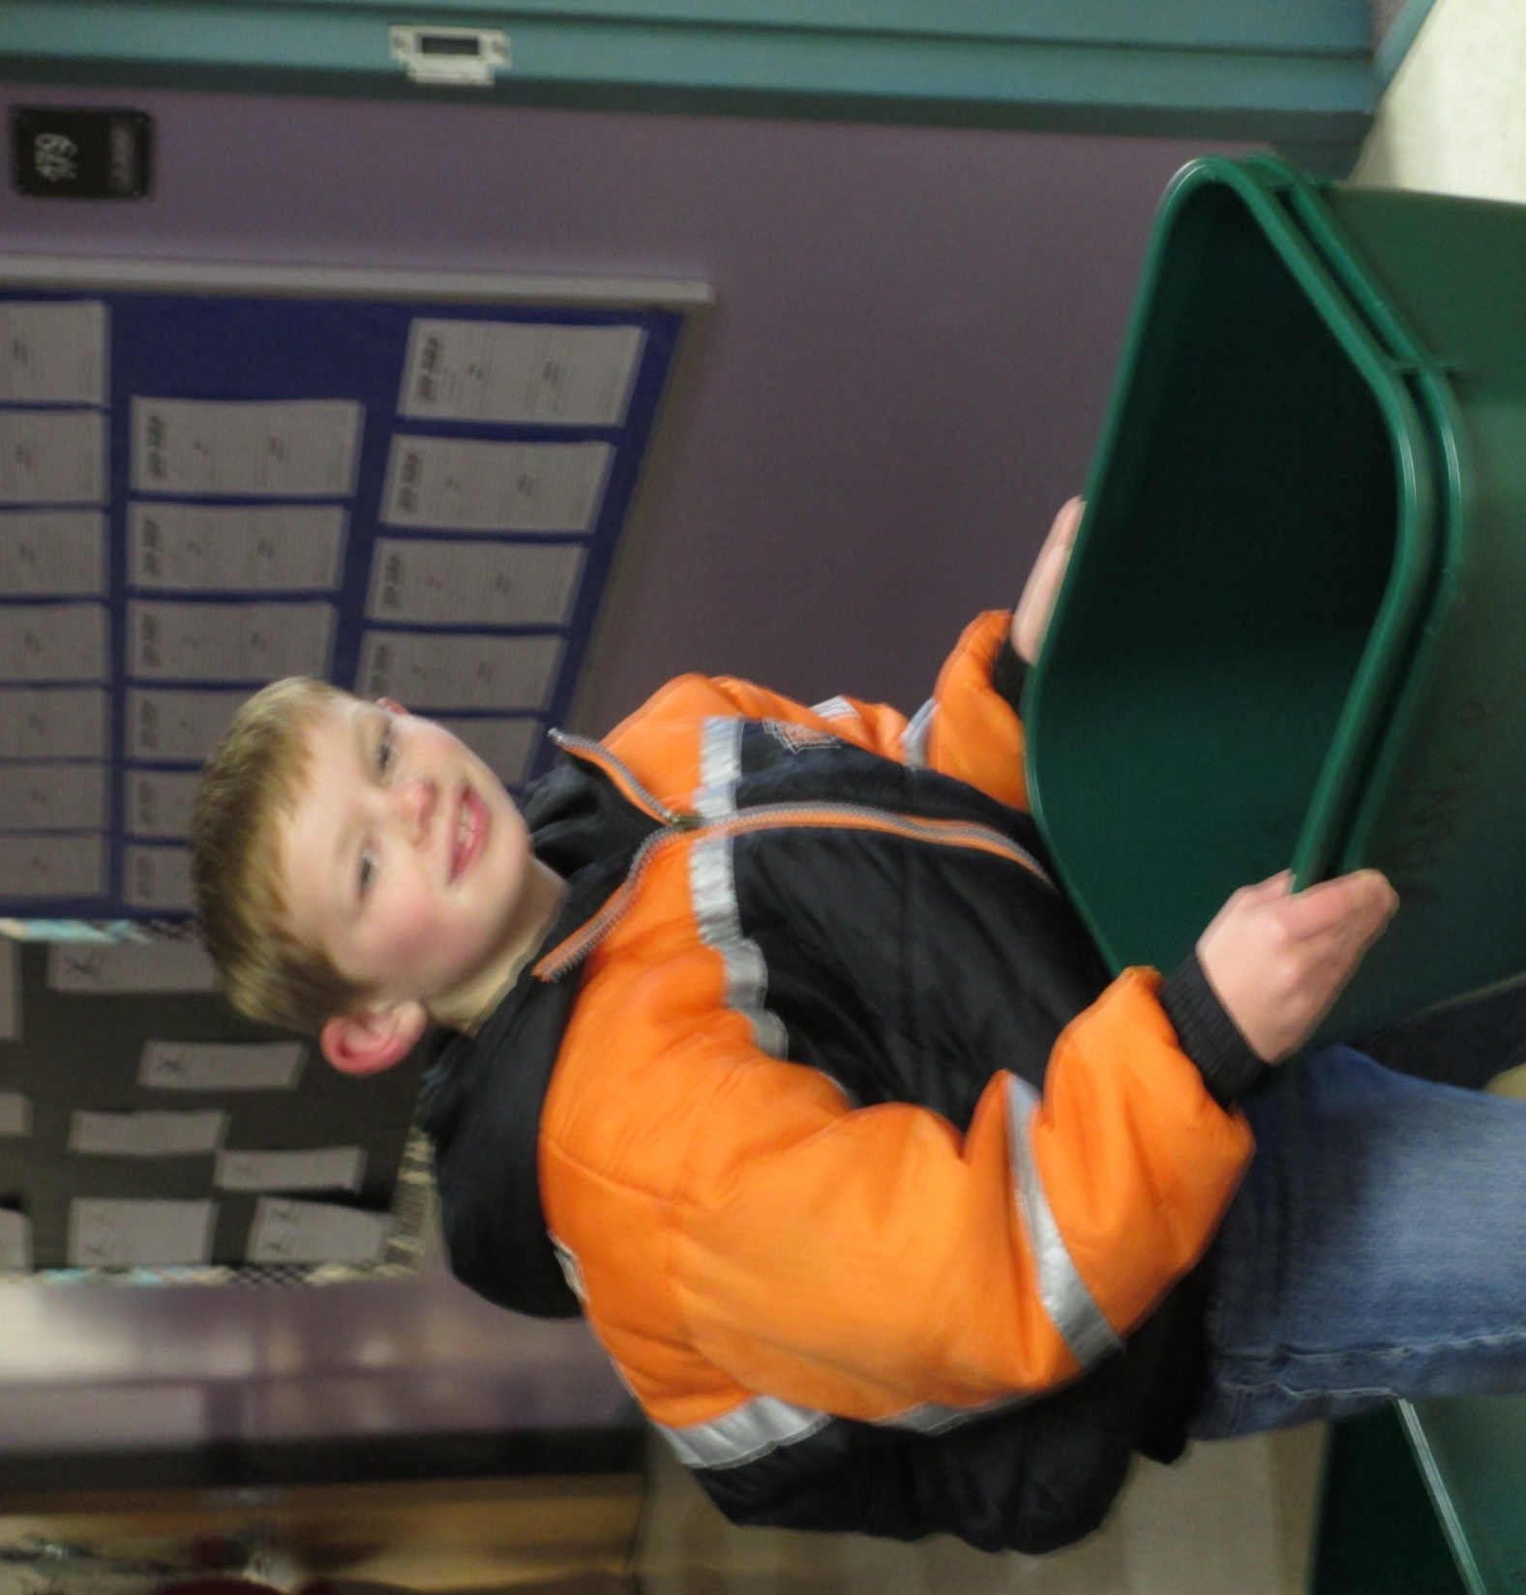

Slide 27
Every week we choose a recycling champion at each grade level. We hold contests and speak to our assigned classes about recycling. We try to encourage everyone to recycle more!

Slide 28
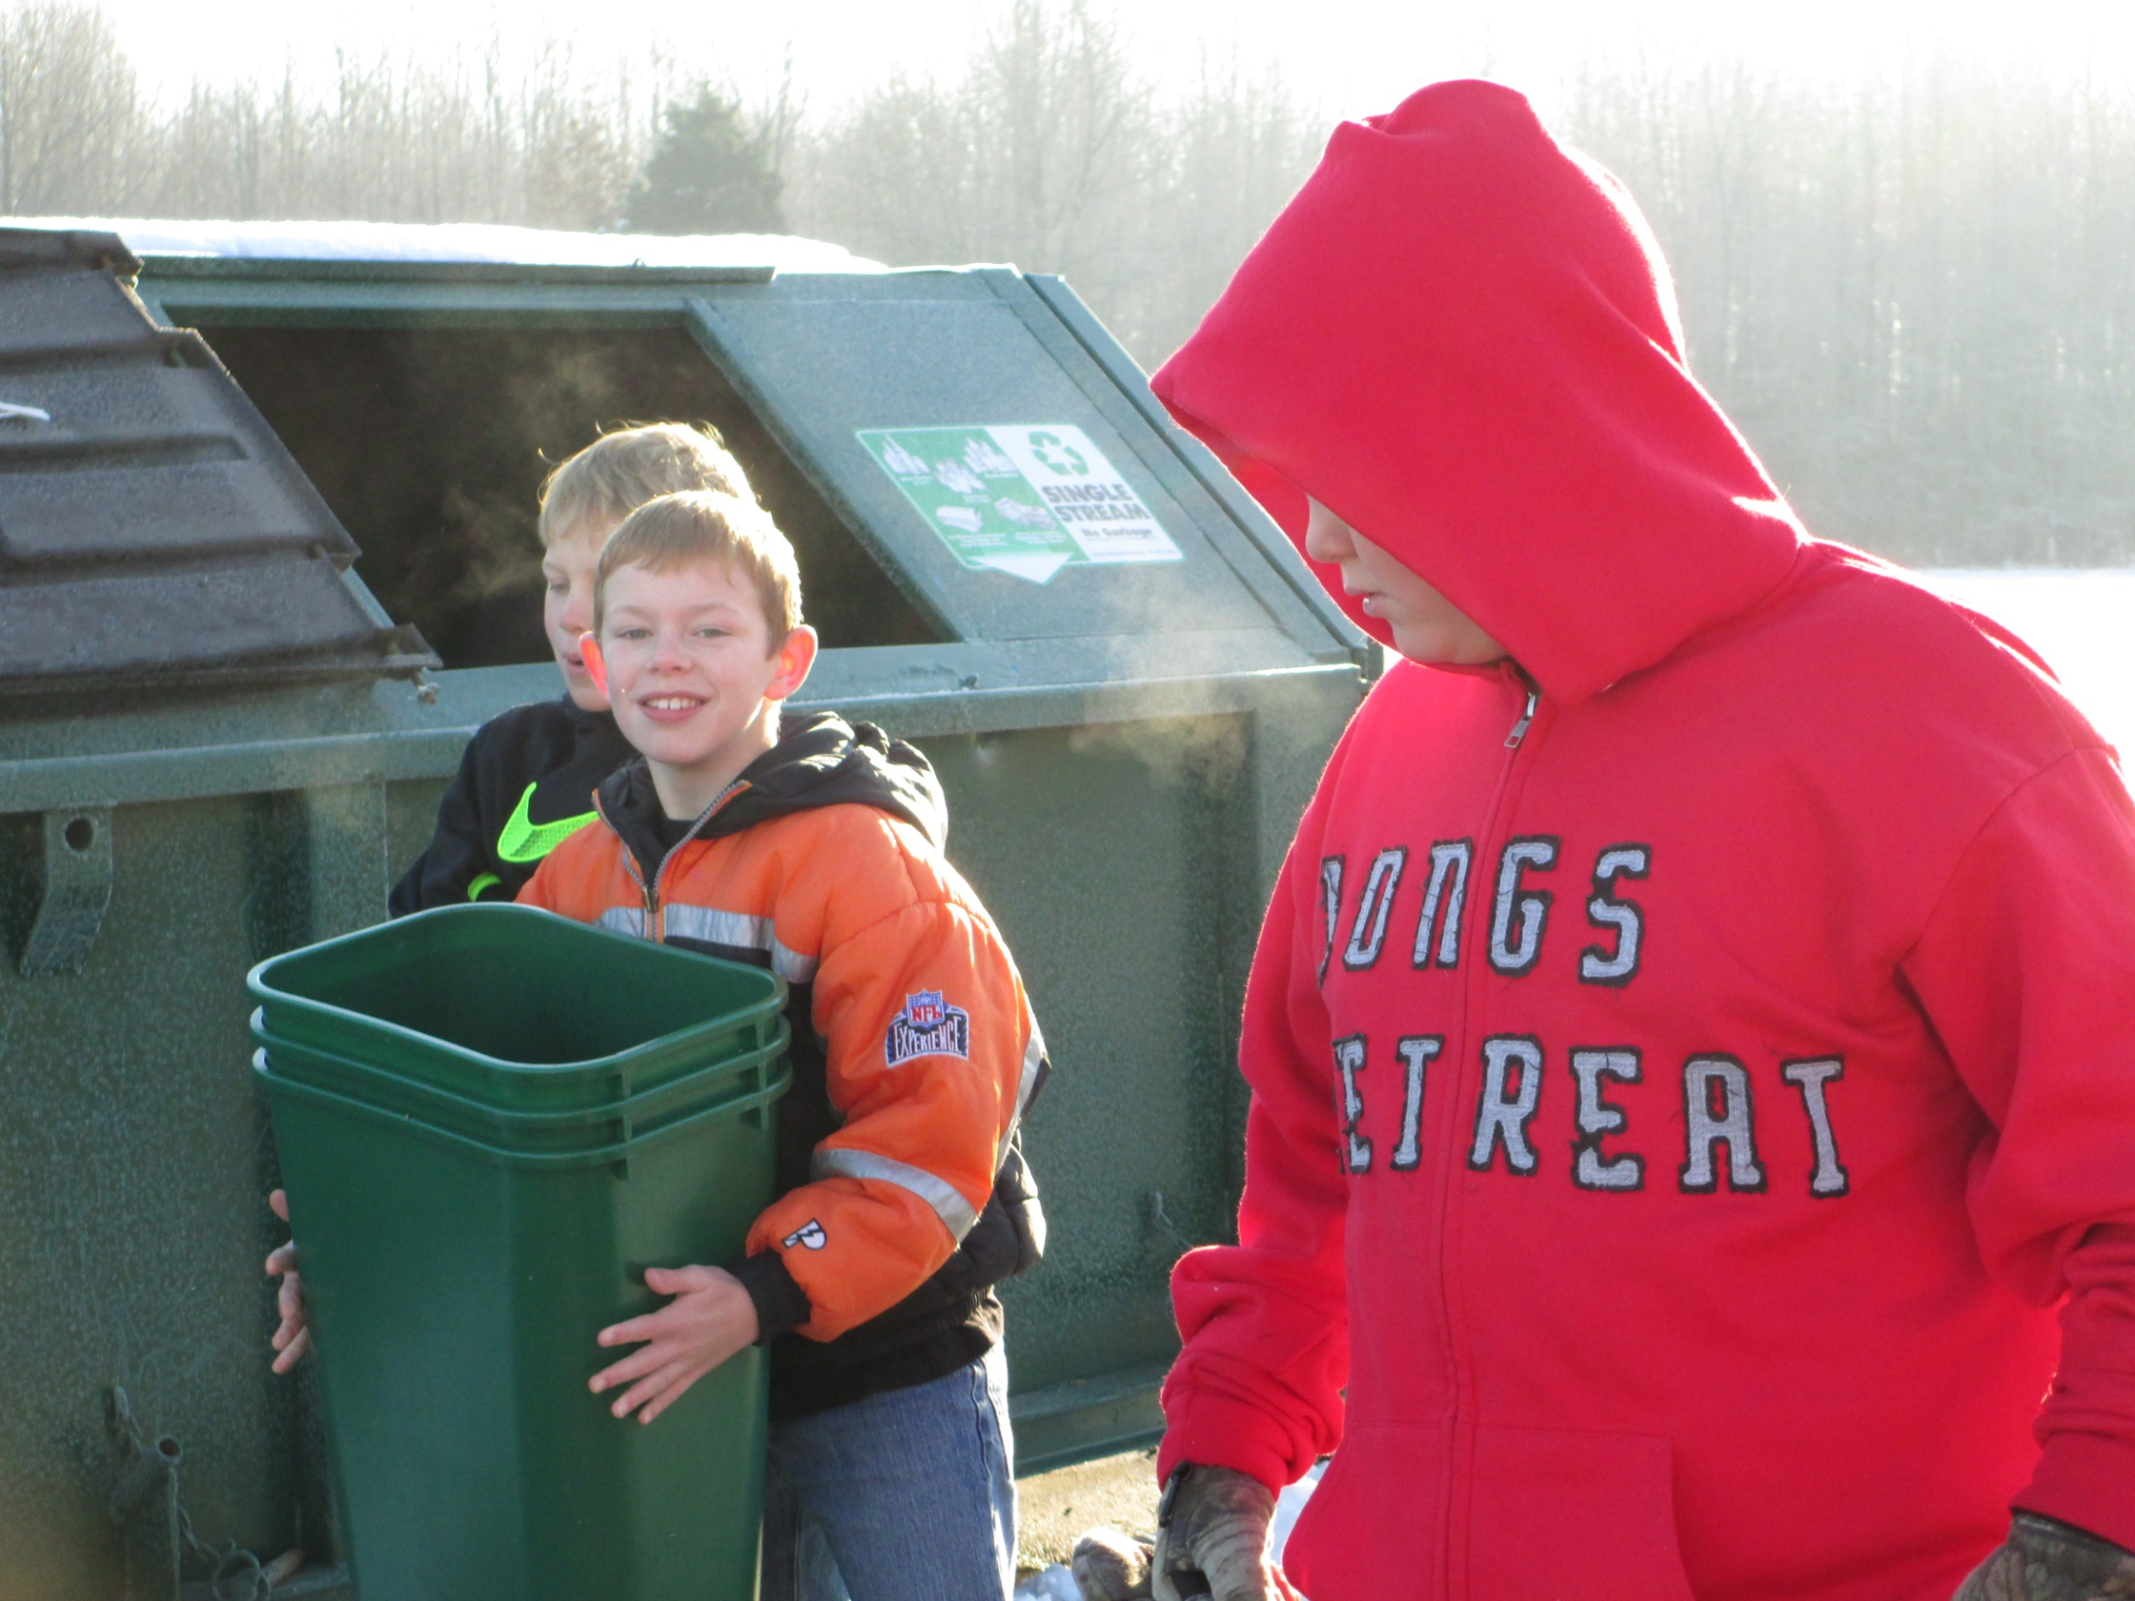

Slide 29
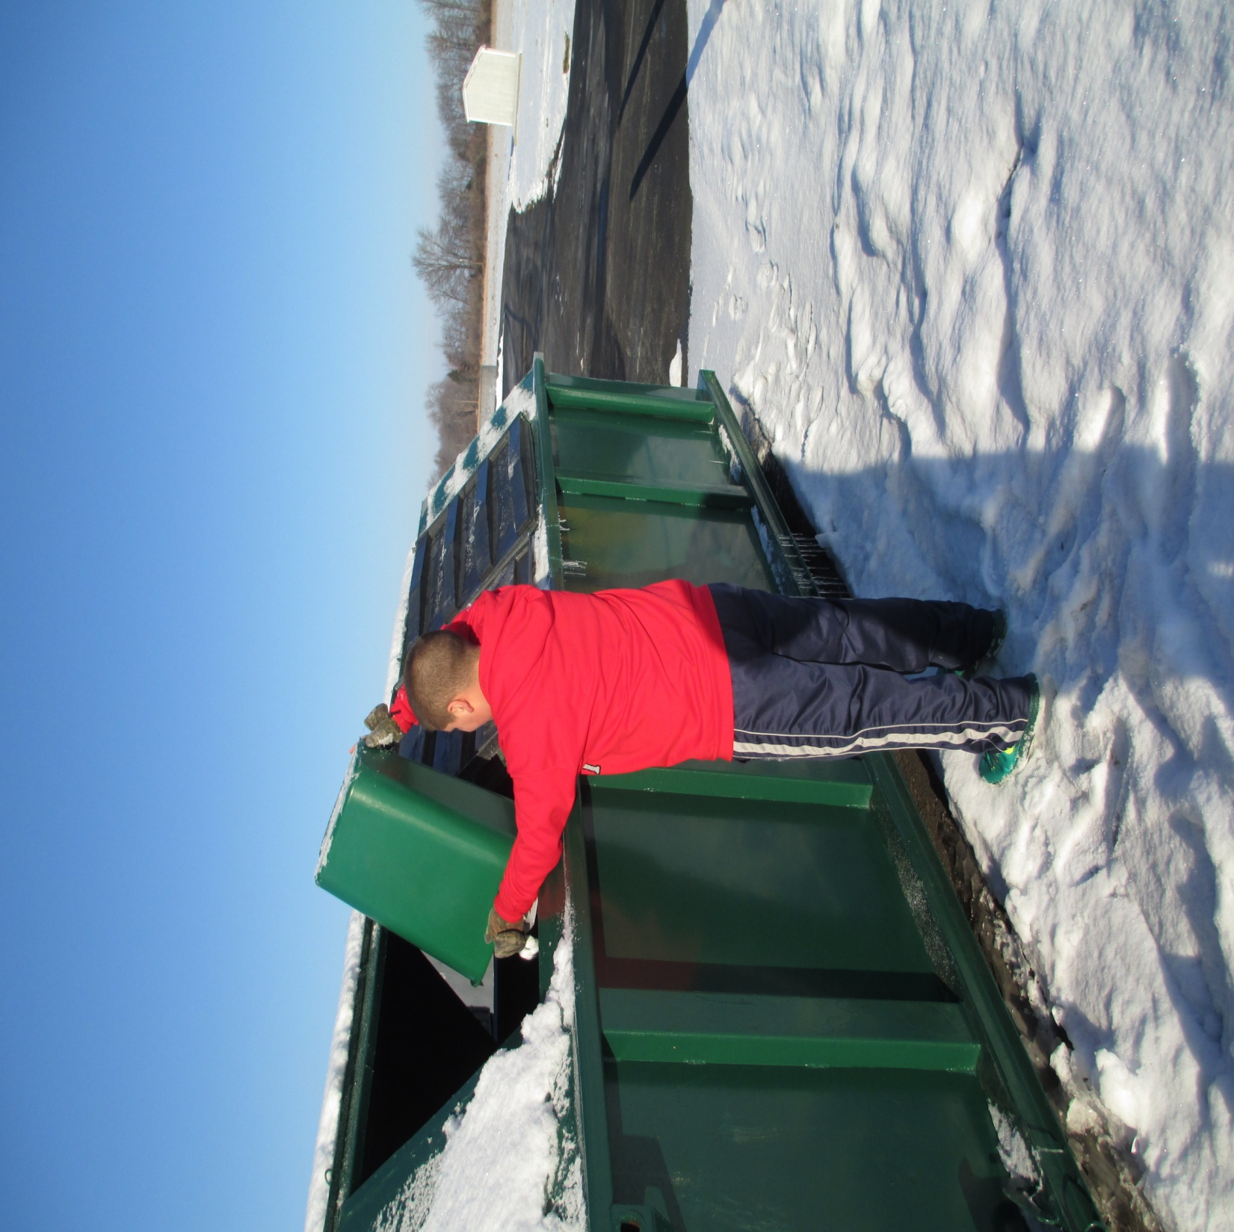

Slide 30
